Slide 1
Advocacy in Action
Mock Legislative Committee Hearing
Welcome!

Slide 2
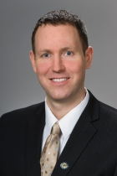
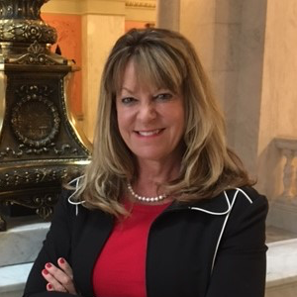
Get to Know the Committee
Representative
Erica Crawley (D-Columbus)
Representative Louis Blessing, III (R-Colerain Twp.)
Nathan Minerd,
Momentum Strategy Group
Connie Nolder,
CRN Consulting
(Lobbyist)

Slide 3
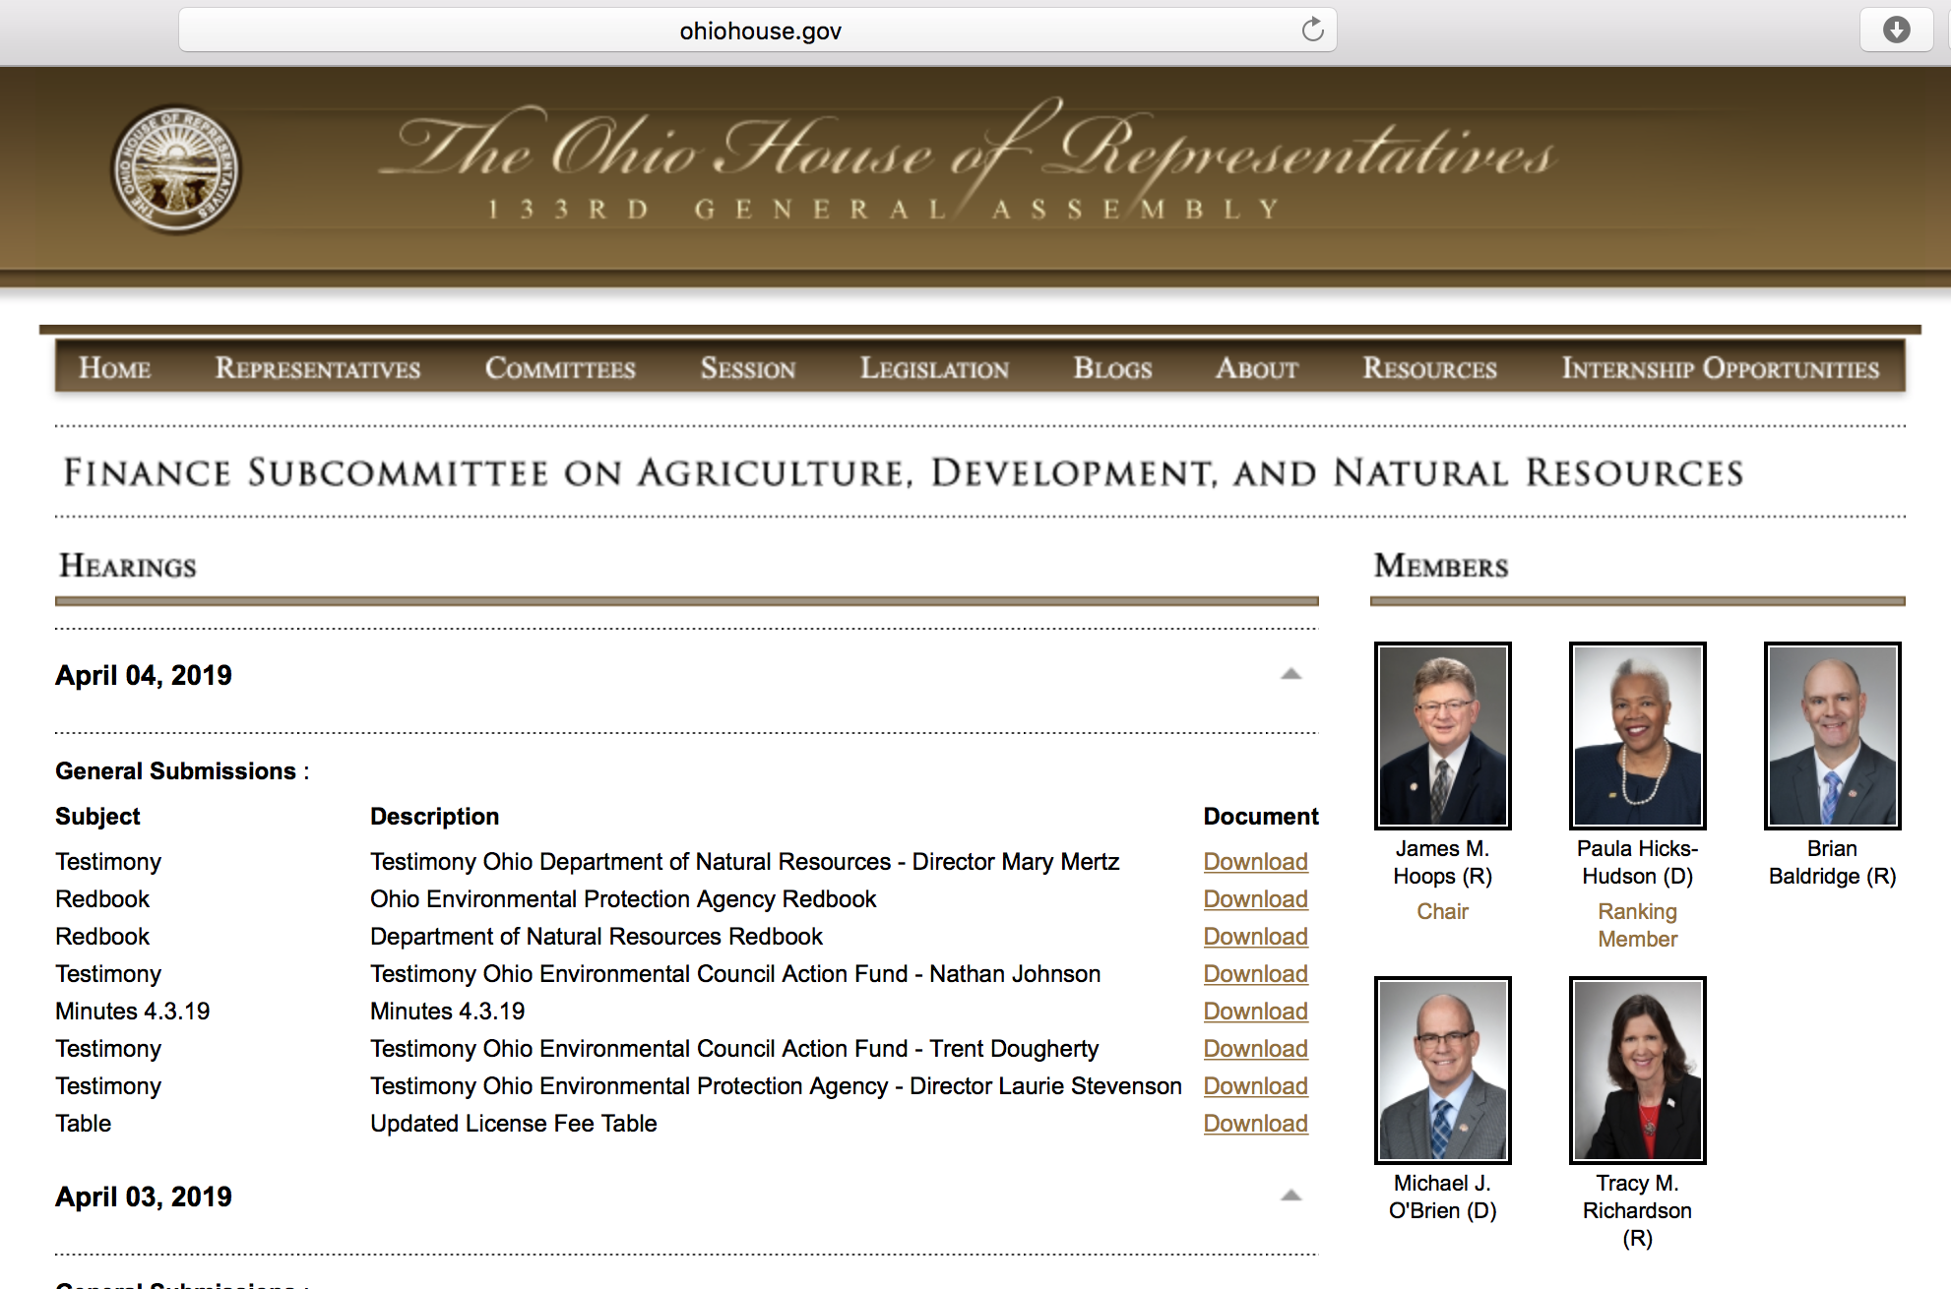
Mock: House Finance SubCommittee Honorable Louis Blessing, Chair
Prepare for hearing
Prepare testimony
Submit testimony
Testify before committee
Committee follow-up
What worked, what didn’t?
What happens next?
More hearings, vote, floor

Slide 4
Q & A (Audience participation)
11:00 – 11:15 a.m.

Slide 5
Where Does Advocacy Start?
Determine your goals with reality of the political climate in mind
Educate yourself on your audience – who are the key legislators involved in your issues
Research your issue – what has been introduced in the past, what have states done, current and past policies
Stay engaged in current affairs – read news, blogs, op-eds, etc.
Develop a simple and effective message (MORE ON THIS)

Slide 6
Where Does Advocacy Start? (CONT.)
6. Begin meeting with legislators, key state agency decision makers and other interested parties
7. Evaluate your arguments following feedback form meetings. Fine-tune your message.
8. Identify key legislator to introduce proposal/carry amendment. (Your sponsor)
9. Once legislation is introduced the process begins – back to the basics
10. Stay engaged, stay persistent but polite, and don’t give up!

Slide 7
Gina’s Five R’s
RELATIONSHIP
RELEVANCE
RECENCY
RATIONAL
RESEARCH
POLITE

Slide 8
Connie’s Three P’s
PERSUASIVE
PERSISTENT
POLITE

Slide 9
Now it’s your turn!! (Audience participation)
Goal: Ohio Housing Trust Fund Budget Increase
In your small group of 5-8 people, collectively decide how to craft your best 3 arguments to persuade legislators, policymakers and the public on why this is a good idea. (10 minutes)
Choose 1 or 2 advocates to present your argument to the group. (3 minutes)
Provide positive feedback and kind critique of the presentation. (2 minutes)

Slide 10
NOW IT’S REAL – TODAY IS THE DAY
Politics are local!
-Distinguish Yourself
-Compelling outreach with a unified message on how the OHTF can help your community
-OHTF can SOLVE problems
-This is win-win proposal!
Who is your State Representative? Who is your State Senator?
Go to ohiohouse.gov or ohiosenate.gov and enter in your zip code to find out!
Are they on Finance committee?
E-mail them at rep00@ohiohouse.gov
Ask them to submit Blessing’s OHTF amendment as one of their priority amendments.

